Slide 1

What is the Respiratory Care Interstate Compact?

Slide 2

Engaging the audience
The Respiratory Care Interstate Compact (RCIC) is an interstate occupational licensure compact for respiratory therapists.
There are approximately 130,000 licensed respiratory therapists in the United States. Licensees currently face significant barriers to providing services across state borders, even when they meet the qualifications to practice in another state. The Respiratory Care Interstate Compact will facilitate multistate practice by reducing unnecessary licensure burdens and improve public safety by enhancing state information sharing.

Slide 3
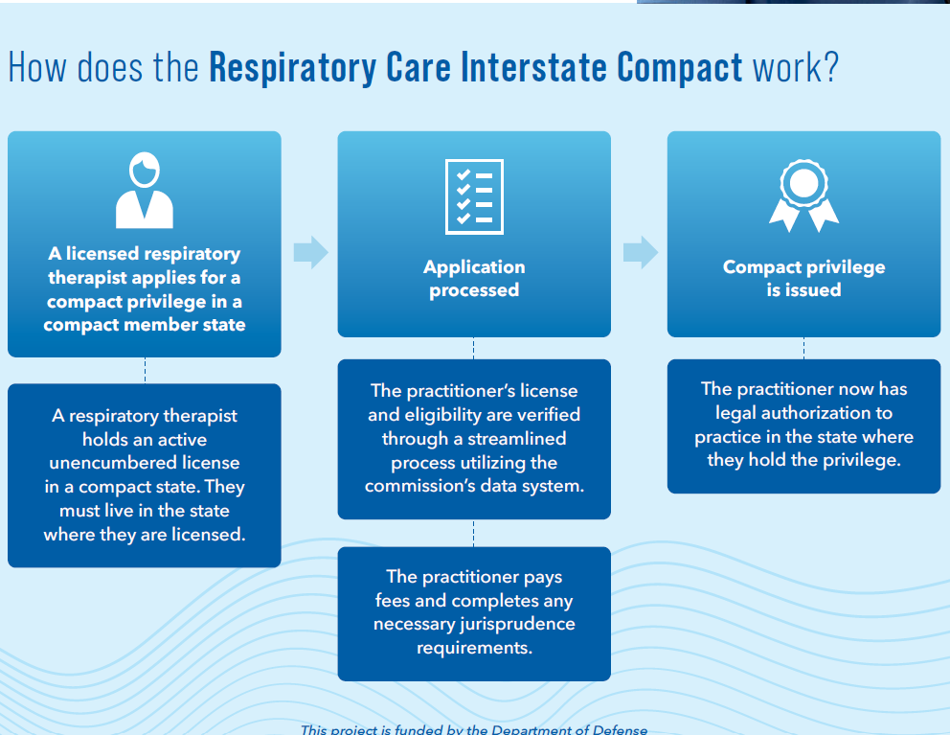
Compact

Slide 4
Timeline- Compact
Introduce State Compact License
Nebraska therapists or (NSRC) have introduce the compact legislation- Goal January session 2026
Pass through committee
The legislation need to pass through committee to be introduce to the floor at the Nebraska unicameral
Pass Votes at the State
Nebraska Unicameral need to pass the bill for our state to be part of the compact
Once the state legislation is passed
State DHHS becomes part of the compact license committee
When will compact State
We need 7 states to pass the legislation in their states, to stand up the Compact- once the compact is stood up, it can take up to two years to start.

Slide 5
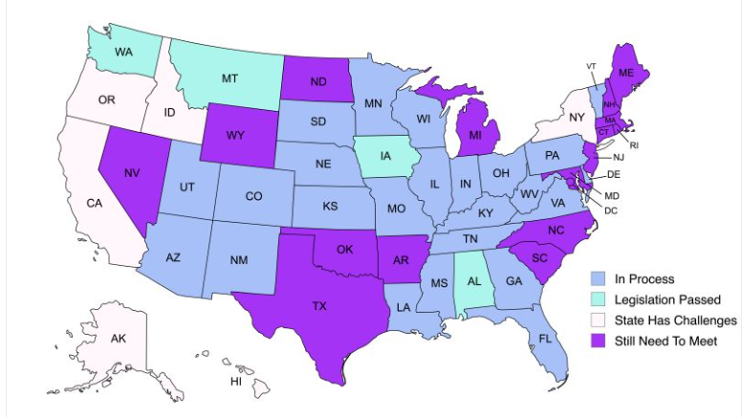

Slide 6
Final takeaways
Poster Presentation
Promoting high-quality clinical outcomes
Great way to share your hard work
Timing/Deadline
January 15th, 2026
RCIC
Get involved in promoting the Compact

